Slide 1
Chapter 38 Maxwell’s Equations and Electromagnetic Waves

Slide 2
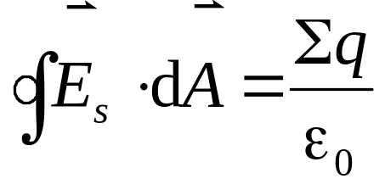
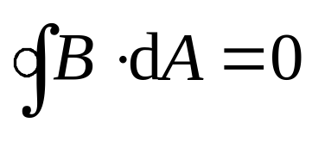
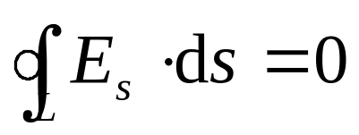
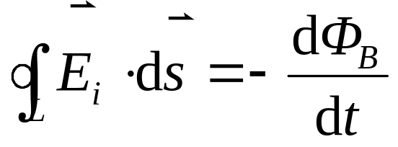
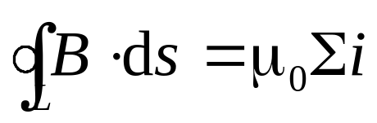
The Basic Equations of Electromagnetism
Consider the similarities of electric and magnetic fields in their mathematical properties.
Gauss’laws
A changing magnetic field
Faraday’s law
A electric field
magnetic field
Ampere’s law
Moving of electric charge

Slide 3


The Basic Equations of Electromagnetism
Ampere’s law

Slide 4
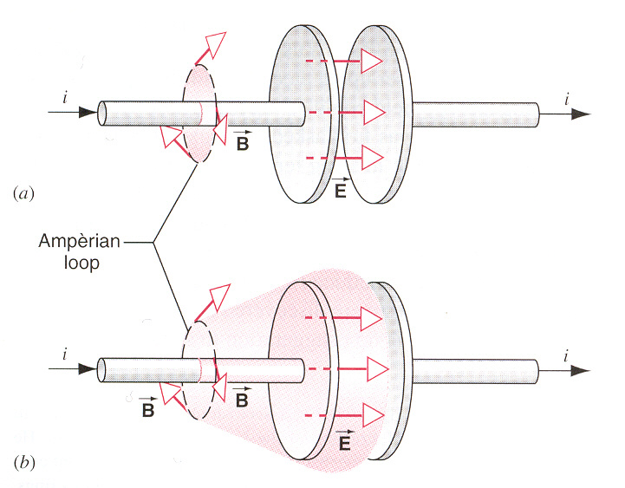
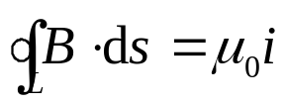
The Basic Equations of Electromagnetism
Ampere’s law

Slide 5
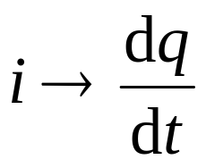
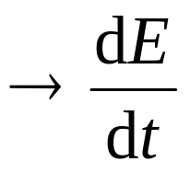
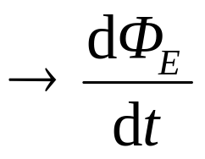
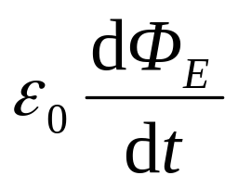
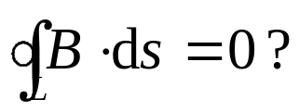
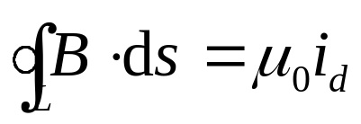
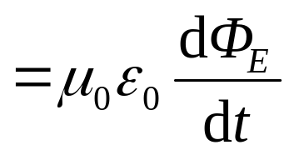
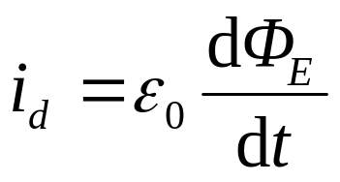
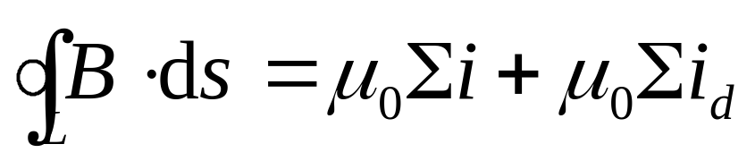
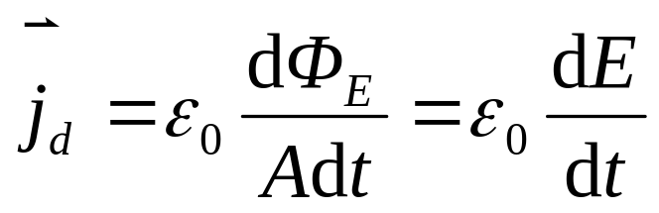
The Basic Equations of Electromagnetism
define as i_{d}
Displacement Current
The displacement current in the gap equals the conduction current in the wires.
Ampere’s law
Intensity of displacement current

Slide 6
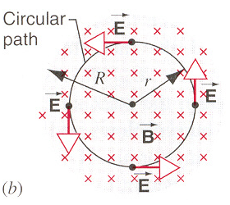
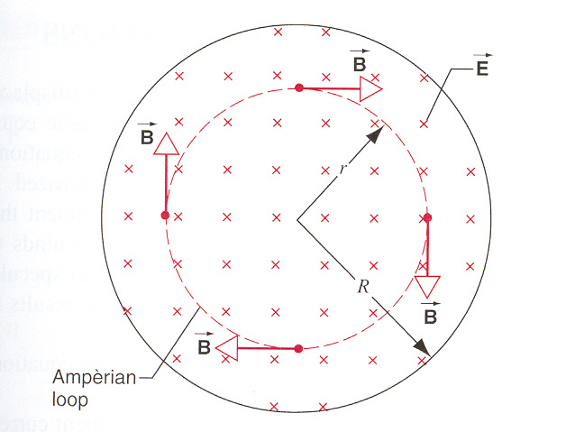
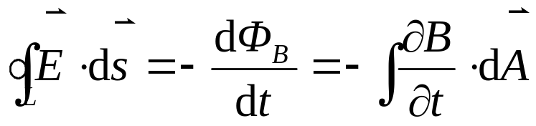
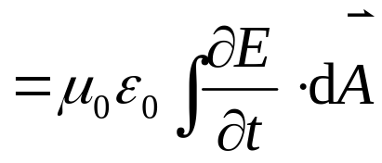
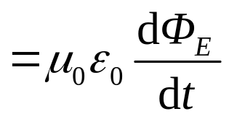
A changing magnetic field
a electric field
A changing electric field
a magnetic field
A beautiful example of the symmetry of nature.

Slide 7
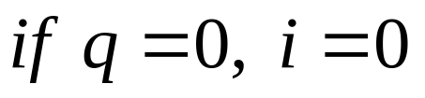
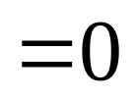
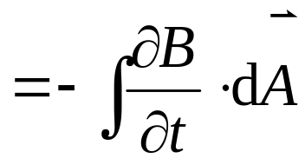
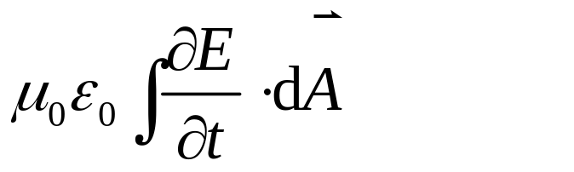
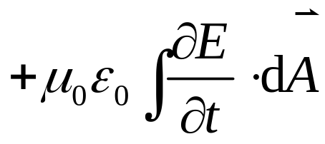
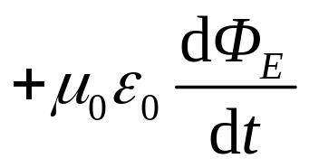
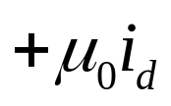
Maxwell’s Equations
Gauss’laws
Faraday’s law
electromagnetic waves
Ampere’s law
A charge in motion at constant speed
An electric charge at rest
A charge in accelerated motion

Slide 8
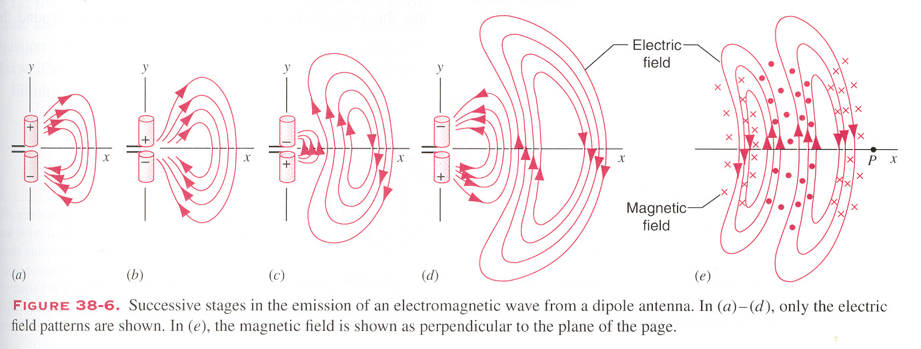
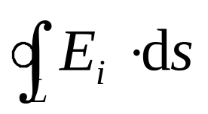
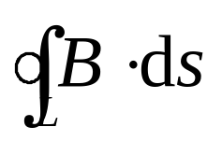
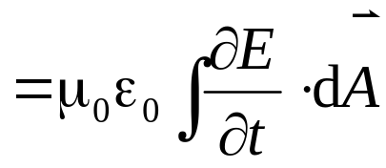
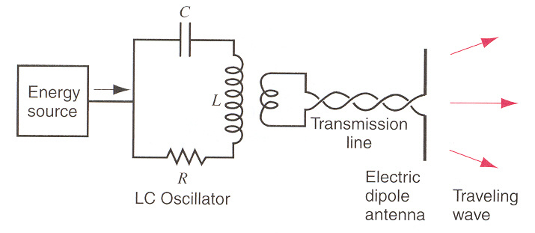
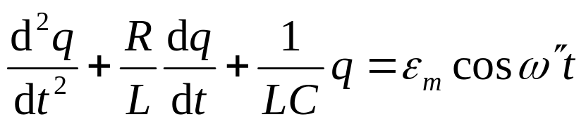
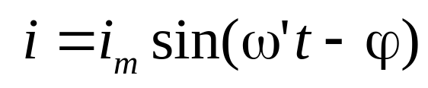
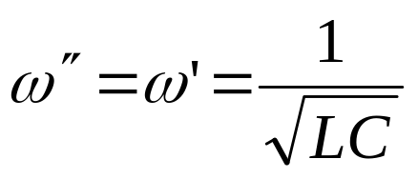
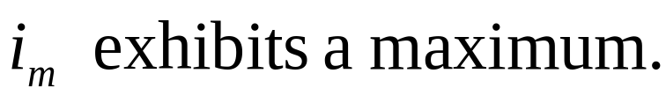
Radiation from oscillating dipole
+
-
oscillating electric dipole electric dipole radiation

Slide 9






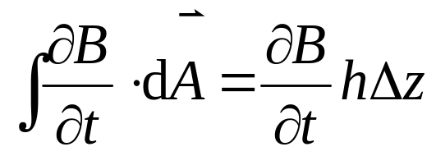
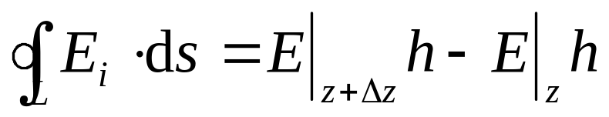
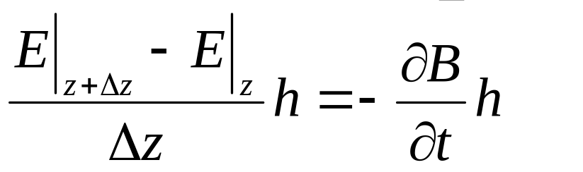
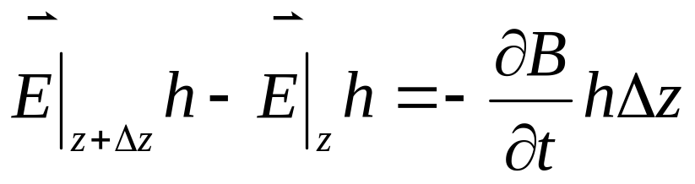
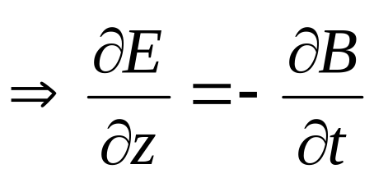
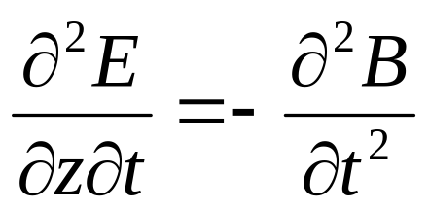
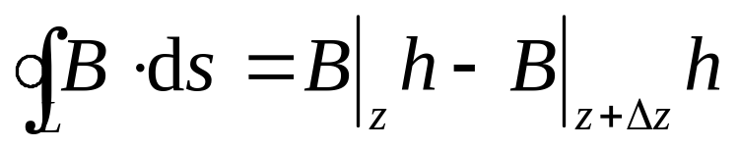
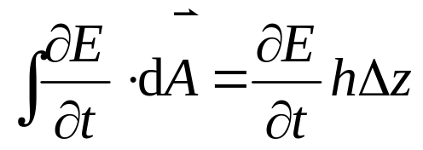
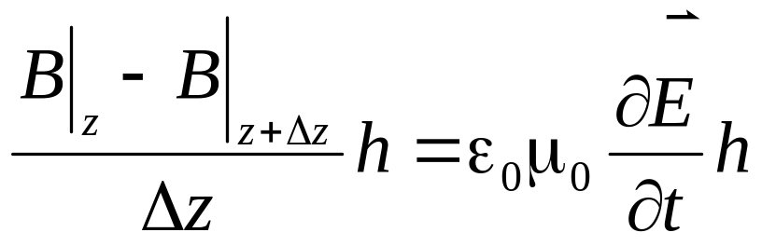
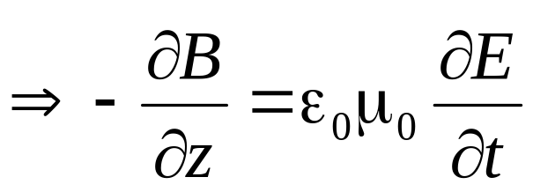
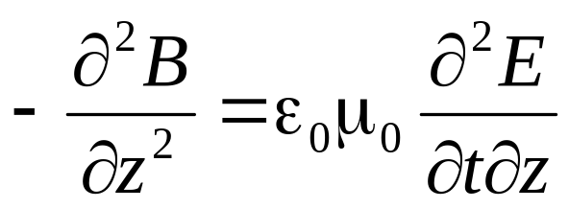
Radiation from oscillating dipole
+
-

Slide 10
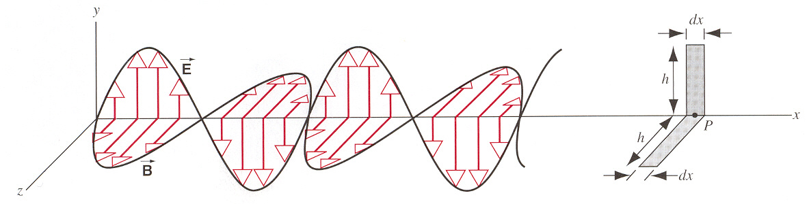










Radiation from oscillating dipole
E⊥B, and E⊥k, B⊥k, k is the direction of the wave.
y
Polarization of electromagnetic waves
z
x
The speed of electromagnetic wave
E and B are in phase
electromagnetic waves

Slide 11









Vector

Slide 12










Maxwell’s Equations
Differential forms

Slide 13




























y
z
x

Slide 14








Energy Transport and the Poynting Vector
y
The direction of the propagation of the electromagnetic wave is given by:
This wave carries energy. This energy transport is defined by the Poynting vector S as:
x

Slide 15

















Intensity
The Intensity of a wave :
The energy density

Slide 16







The magnitude of the Poyning vector gives the rate of energy flow. It is the energy of the wave flowing through per unit area in per unit time.
plane wave
sphere wave

Slide 17












The magnitude of the Poyning vector gives the rate of energy flow. It is the energy of the wave flowing through per unit area in per unit time.
comet’s tail pushed away from the sun.
Momentum p=
Intensity I =
Radiation Pressure

Slide 18



















Example:
A parallel-plate capacitor

Slide 19









Example:
parallel-plate capacitor of radius R. a conducting current i
(1)Find the magnetic field at O, P, Q
(2) Find the Poynting vector at point P
S
O
Q
B
O
Q
E
B
E
S
at points O and Q
at point P

Slide 20













Example:
A conducting current i in a wire with radius R and resistivity ρ.
(1)Find the E and B at point P
(2) Find the Poynting vector at point P
L

Slide 21











Example:
Find the Poynting vector
On wire
On resistance
On ε
On wire E=0, S=0
On resistance
On ε

Slide 22













If there are some resistant in the conductor
Example:
E_{r}
B_{z}
E
v
B

Slide 23
Exercises P876 4, 5, 6
Problems P 880-881 3, 12

